Slide 1
Welcome To The Minneapolis Alpine Ski Team!

Slide 2
Tonight’s Schedule
7:15PM MAST ’13 – ’14 Presentation
MAST Head Coach: Mark Conway
MAST Webmaster: Barbie Alampi
MAST President: Dave Krueger
8:00PM Business at THE TABLES

Slide 3
The Tables
MAST Registration Forms
MPS/MSHSL Forms
Team Fee, Season Pass Fee
Coaches/Equipment
Giants Ridge Information (For Parents)
Parent Volunteering
Captains/Apparel
Car pooling
Fundraising

Slide 4
MAST IS FUN!

Slide 5
THE MAST COMMITMENT..
Provide quality instruction, training, & racing for all team members.
Encourage a welcoming & supportive team atmosphere.
Assist in the development of transferable skills and attitudes.

Slide 6
Opportunity To Develop Useful Life Skills
Goal setting
Positive thinking
Focused and sustained work ethic
Visualization
Delayed gratification
Teamwork
Sportsmanship
Grit

Slide 7
Captains
Captains
Southwest: Andrea Savage and Christian Hedrick
South: Margot Franchett and Seth Koepcke
Washburn: Rachel Anderson and Ben Calvit
Apparel
Captains’ Practices
Tuesdays: Oct 29 and Nov 5
Thursdays: Oct 31 and Nov 7

Slide 8
Christian Hedrick

Slide 9
Margot Franchett

Slide 10
Seth Koepcke

Slide 11
Rachel Anderson

Slide 12
Andrea Savage

Slide 13
Ben Calvit

Slide 14
Meet the Coaches

Slide 15
Paid Staff
Mark Conway (Head Coach)
Joel Hedrick (Assistant Head Coach)
Daniel Polland (Assistant Coach)
Elora Koepcke (Assistant Coach)

Slide 16
Volunteer Coaching Staff
Gary Griffin
George West
Kris Lyons
Deb Bistodeau
Jon Cohen
Jake Yockers
Julie Flaskamp
Tom Fraser
Bill Kirkpatrick
Amy Quinlivan
David Streitz
Thorn Turner
Rich Berg
Scott Griggs

Slide 17
Communication
Emails
MAST Website
Mentors

Slide 18
MAST Website
mplsalpineski.org
Webmaster: Barbie Alampi

Slide 19
Fees
$450 Team Fee
Includes:
Coaching
Equipment (gates, drills, timing, radios, etc)
Hyland Races
Administration Expenses
$349 Season Pass Fee
Unlimited Season Pass To Hyland
Must Be Paid In full By Nov. 5
Season Pass Picture Night: Monday, Nov. 11 @ 7PM @ Hyland

Slide 20
Additional Fees
$50 Invitational Race Fee
Supplemental Training Dates
Giants Ridge Camp
Banquet

Slide 21
Fundraising
Group Fundraising
State Fair Barncleaning: $1600; 60+ People
Pierce OktoberFest: $500
Chipotle on Tuesday, November 19: $$$$
Individual Fundraising
Hoigaards Tent Sale
FlowerPowerFundraising
Wreaths
New….
All Sales Revenue Returns To Athlete

Slide 22
FlowerPower Fundraiser
Flower Bulbs For Sale Through Oct 30
On line sales campaign
Special MAST LINK to track sales to you
50% of Sale Returns To Athlete
Large selection of bulbs
Delivered to purchaser
Plant until ground freezes
Become a Team Member: Sign Up Today or Send Mark an Email at markrobertconway@msn.com

Slide 23
MAST Forms
Registration (on line at mplsalpineski.org)
Power To Authorize Medical Treatment
Assumption of Risk and Release of Liability
Return these forms to Dave Krueger or to the registration table tonight.

Slide 24
MPS/MSHSL Forms
Emergency Information Card
Sports Qualifying Physical Examination Clearance
Athletic Eligibility Brochure/Agreement
Media Release
Return these forms to your high school athletic director!!!
Did you play a high school sport this fall? Return NEW EMERGENCY CARD ONLY!

Slide 25
Ski Tuning
Why It Is Necessary!!!
Learning to Tune Skis
Web: MAST Website, Other
Nov 16 at Fuller Park (Team)
Pierce Skate and Ski: 952-884-1990
Hoigaards: 952-929-1351

Slide 26
Training!

Slide 27
Coach Expectations: Training and Racing
DRYLAND MANDATORY!
Family, Homework, Rest Take Priority ONCE ON-SNOW!
YOU set YOUR schedule according to your goals and needs.
Communicate your plans and intentions regarding days off, RACES, camps to Mark or Joel.
Be safe. Be prepared. Be coachable. Be focused. Be disciplined. Be responsible. Be helpful.

Slide 28
MAST Clinic Day
Saturday, November 16, 11:30AM-2:30PM @ Fuller Park (48th Street and Grand Ave. S.)
Tuning Clinic
Boot Alignment/Equipment Check
Technique Clinic
Racing Rules
Goal Setting
Tuning Instructions are on the MAST website.

Slide 29
Dryland
Dryland at Washburn High School
--Starting Tuesday, Nov. 12
4:30-6PM
Wear running shoes/ layers of athletic clothing—including hat and gloves/ jacket/
NO SHORTS ALLOWED!!!
Bring Water Bottle
Dryland continues Monday-Friday until Hyland opens
WE EXPECT YOU TO ATTEND!

Slide 30
Training: Schedule
MAST Calendar Updated at www.mplsalpineski.org.
Changes after Nov 11 Will Be Communicated Via Email As Well.
Early On Snow: 6:30-8:45PM South Chair

Slide 31
Hyland Training Schedule
Two Team Designation: MAST and MPLS SW
When Separated:
MPLS SW Training: 5:00-7:30PM
MAST Training: 6:30-8:45PM
When Together (Two Lanes): Many Options
7:45-10:30AM; 4:30-6:30PM; 5-7:30PM; 6:30-8:45PM

Slide 32
Camps

Slide 33
Giants Ridge Training Camp
Thursday, January 23-Sunday, January 26
3:30 Load @ Washburn
Sunday ETA: 6PM
Train Friday
Race and Train Saturday
Free Ski and Family Day on Sunday Morning
Depart GR @ 2PM Sunday
Lodging at GR Sports Dorm
Camp Fee: $260 w/ bus; $210 w/o bus

Slide 34
Supplemental Training
Fundamentals Training: Saturday, Nov 30 or Dec 7 9AM-4PM at Welch
Welch Gate Training (4PM -10PM)
Saturdays: Dec. 7, 21 and Jan. 18
Wild Mt Gate Training (4PM-10PM) Saturday, Feb 1
Cost: $45 for lift ticket and transportation

Slide 35
Getting The Most Out Of Training !
Care For Your Equipment
Arrive On Time; Dress Warm
Train Hard and Smart; Rest Well; and Eat Healthy
Make Every Run Count
Learn the Fundamentals
Set Goals
Watch Video
Search the Web

Slide 36
Deep Practice
Two Books By Daniel Coyle: The Talent Code and The Little Book of Talent

Slide 37
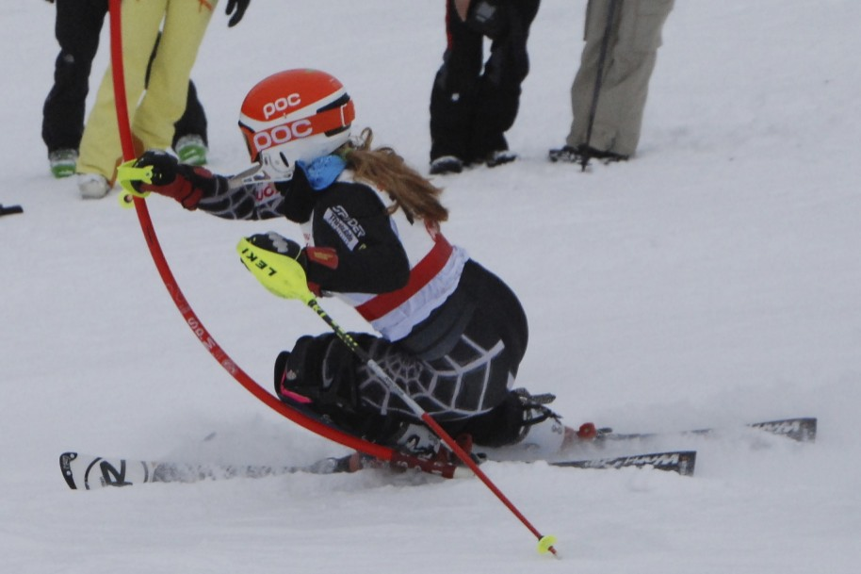
Video on Sprongo
MAST Sprongo Video Sharing
USE IT TO DEEP PRACTICE!!!!
ACCEPT THE SPRONGO INVITATION; USE ONE EMAIL ADDRESS FOR EACH ATHLETE

Slide 38
Racing!

Slide 39
Racing: Dual Meets
All Athletes: Varsity (10 per squad) and JV
Hyland Races: 4:30PM Start
Parent Volunteers Needed
Schedule
Dec 16 v BSM, MWT @ Hyland
Jan 2 v Wayzata, Edina, BSM @ Hyland
Jan 6 v BSM, Orono, MWT, Armstrong-Cooper @ Hyland
Jan 13 v BSM, Orono, MWT @ Hyland
Jan 25 v Virginia, Hibbing @ Giants Ridge 10AM Start?
Jan 28 v BSM, Orono, MWT, Armstrong-Cooper @ Hyland

Slide 40
Racing: Invitationals

Slide 41
Racing: Invitationals
Wild Mt on Friday, December 20
MAST (South/Washburn Squad)
SW Squad
6 Boys/6 Girls per Squad
24 Athletes Total
Buck Invite on Friday, Jan 10
MAST (South/Washburn Squad)
SW Squad
8 Varsity Spots/ 6 JV Spots per squad
--OR--
Welch Invite on Friday, Jan 17
MAST (South/Washburn Squad)
SW Squad
6 Varsity Spots/ 4 JV Spots per squad

Slide 42
Additional Junior Varsity Racing
Hyland JV Races
4:15PM Start
Fridays: Jan 10?, 17?, 31, and Feb 7

Slide 43
Racing: Championships
Section IV @ Wild Mt on Wednesday, Feb. 5
6 boys/ 6 girls from South, SW, and Washburn.
Top 15 individuals advance to State Championship on Wednesday, February 12 @ Giants Ridge
Top 2 teams advance

Slide 44
Athlete “Race Intentions”
FOR EACH RACE: ATHLETE MUST ACCEPT OR DECLINE THE INVITATION TO RACE ON THE MAST WEBSITE
PROVIDES A “CLEAN” RUN ORDER AND ENABLES THE COACHES TO PROMOTE ATHLETES TO VARSITY STATUS WHEN POSSIBLE

Slide 45
Race Day Parent Help Needed
Race Workers
Scoreboard Recorders
Gate Judges (Training Provided)
Timing
Starter
Bib Distribution/Collection

Slide 46
Race Worker Training Dates
MAST TRAINING @ Fuller Park (48th and Grand Ave. S.)
Saturday, November 17 @ 11:00-12:30PM
Saturday, December 7 @ 11:30AM-1PM
USSA OFFICIALS TRAINING: NOV 2 OR 3 @ TWIN CITIES ORTHOPEDICS

Slide 47
Concussions
Definition
Concussions Happen in Ski Racing
Risks of returning too soon…
Brain swelling, headaches, dizziness, memory loss, concentration issues, fatigue, sleep difficulties, personality changes, sensitivity to light….
State Law: “provider” clearance to return to activity….

Slide 48
ImPACT Baseline Testing
“Immediate Post-Concussion Assessment and Cognitive Testing”
Baseline Testing
Compare baseline test results and post-injury test results to determine the extent of damage, track recovery, and determine when an athlete is safe to return to play.
One tool physicians can use to assess recovery

Slide 49
Why Be Safe?!
Goal: “Eliminate the risk of recurrent or permanent injuries that may have permanent or temporary health risks.”

Slide 50
Impact Baseline Testing
On line Testing–
At SW
After School On Monday, November 11 3:15PM and 4:30PM.
Measures reaction time, attention span, memory, problem-solving
Results confidential– can only be accessed by your provider
More information will be emailed this week!

Slide 51
ADDITIONAL TRAINING
SEASON ENDS FEBRUARY 12
TEAM GILBOA HIGH SCHOOL TRAINING PROGRAM AND POST SEASON TRAINING WWW.TEAMGILBOA.COM
HYLAND JUNIOR RACE TEAM CHECK WITH HSSA FOR MORE INFORMATION

Slide 52
MAST President: Dave Krueger

Slide 53
MAST Board
President: Dave Krueger
Vice President: Jack Goodnow
Treasurer: Susan Steen
Asst Treasurer: Marianne Carolan
Asst Treasurer: Erle Savage
Secretary: Nancy Koepcke
Webmaster: Barbie Alampi
At Large: Darryl Savage
At Large: Kevin Counifhan
At Large: Michelle Streitz
At Large: Shannon Foulkes

Slide 54
Parent Volunteers :: Immediate Needs
Giants’ Ridge
General Coordinator (communications, family lodging, assist Meal coordinators)
Meal Coordinator
Breakfast Coordinator
Banquet
Committee Leader
Committee
Master Volunteer Sign-Up Sheet

Slide 55
Registration Reminders
Register @ www.mplsalpineski.org
MAST Forms to Dave Krueger
MAST Assumption of Risk and Liability Release
MAST Power to Authorize Medical Treatment
MPS & MSHSL Forms
Visit www.mplsalpineski.org for school details.
School and State forms are due to your Athletic Director by 10/29.
Checks Made Payable to Mpls Alpine Ski Team
Send Payments to Susan Steen/ MAST Treasurer/ 2800 Brookwood Terrace, Mpls, 55410
Team Fee $450 = $75 deposit + $375 or fundraising equivalent
$349 for Hyland Season Pass (unless you will acquire your HSSA pass separately)

Slide 56
Fundraising Opportunities
Dunn Bros program has been discontinued
We are close to settling on a similar individual fundraising program
Wreath Sales
Flower Power

Slide 57
The Tables
MAST Registration Forms
MPS/MSHSL Forms
Team Fee, Season Pass Fee
Coaches/Equipment
Giants Ridge Information (For Parents)
Parent Volunteering
Captains/Apparel
Car pooling
Fundraising

Slide 58
Questions?

